Slide 1
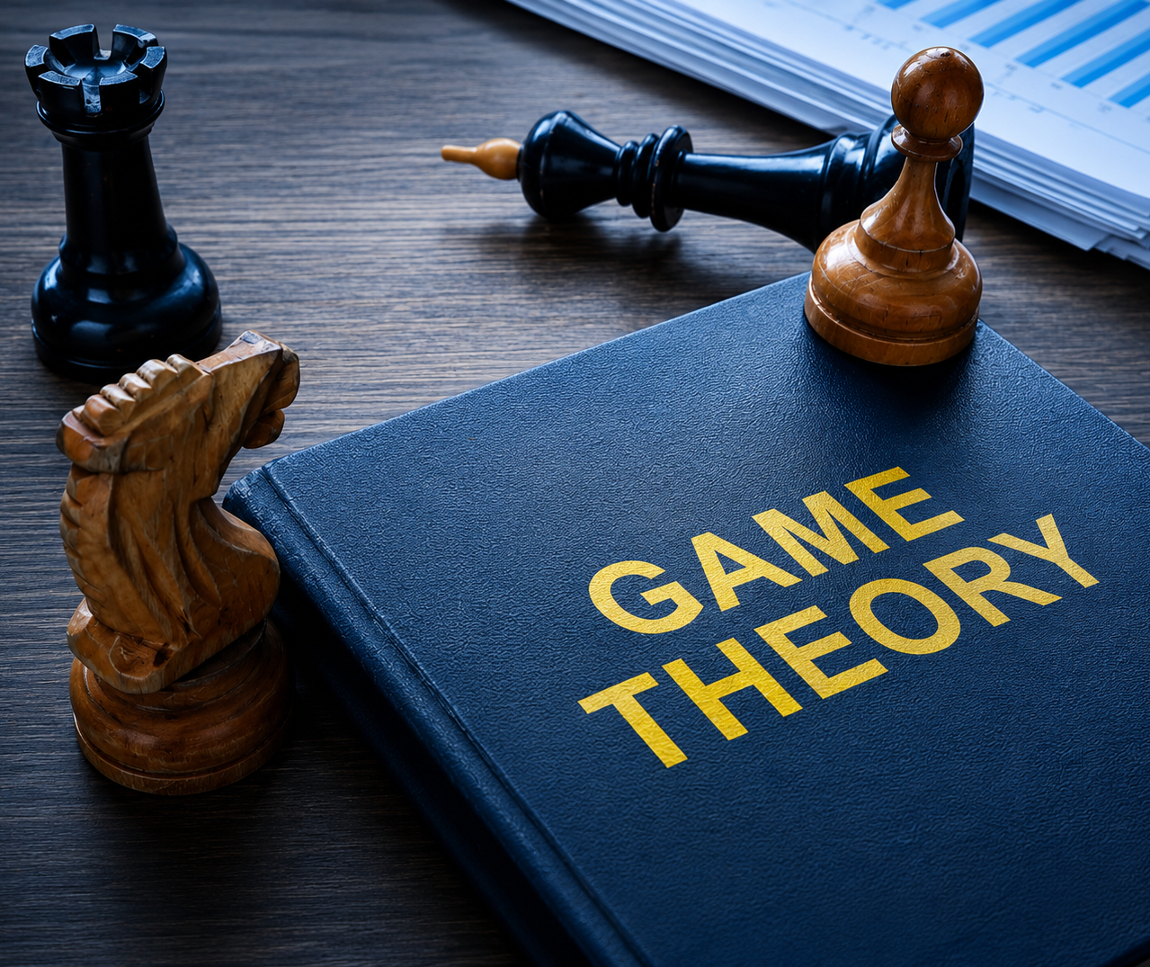
Game Theory Thirteen
Candidacy Topics
Benefits of Scaling Payoff Matrices
Soft ReLU Activation Function
_____
Jacob Wyngaard

Slide 2

Candidacy Topics
Paper
From Mean Field Games to Navier-Stokes Equations by Luo and Song
Numerical Analysis (Dr. Fok)
Initial Values Problems for ODEs (Chapter 5, LeVeque)
Absolute Stability for ODEs (Chapter 7, LeVeque)
Stochastic Calculus (Dr. Rizzolo)
Brownian Motion Calculus (Chapter 4, Klebaner)
Stochastic Differential Equations (Chapter 5, Klebaner)
Numerical Analysis (Dr. Guyenne)
Fluid Mechanics (Chapters 1.1-1.11 and 2.1, Landau)
Hamiltonian Dynamics (Chapter 1, Swaters)
Tentative (Meeting Wednesday)

Slide 3

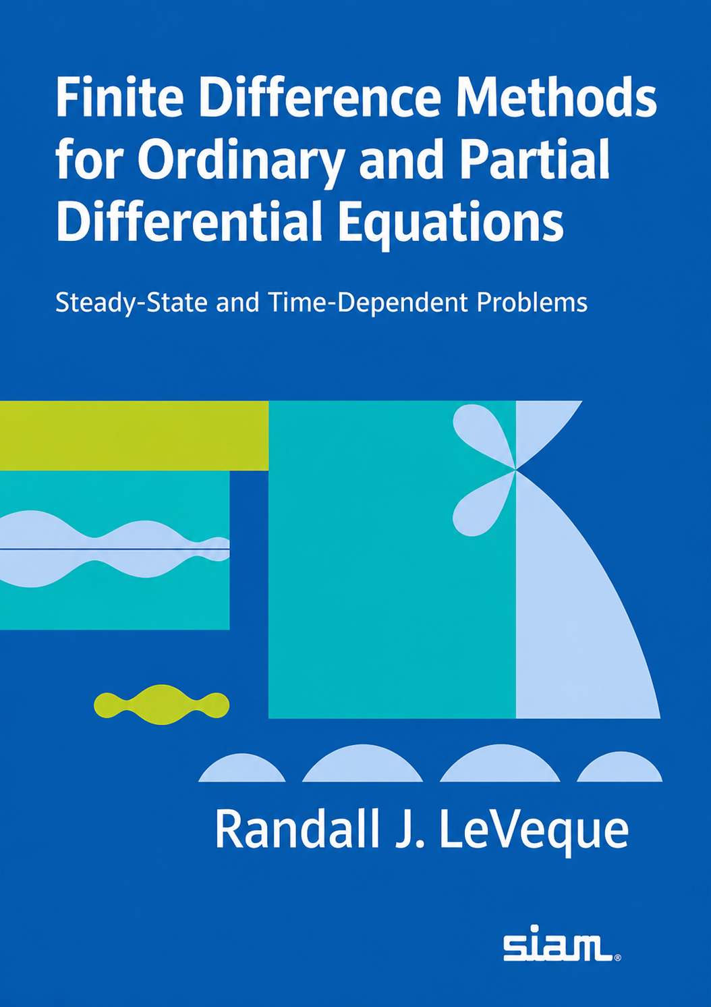
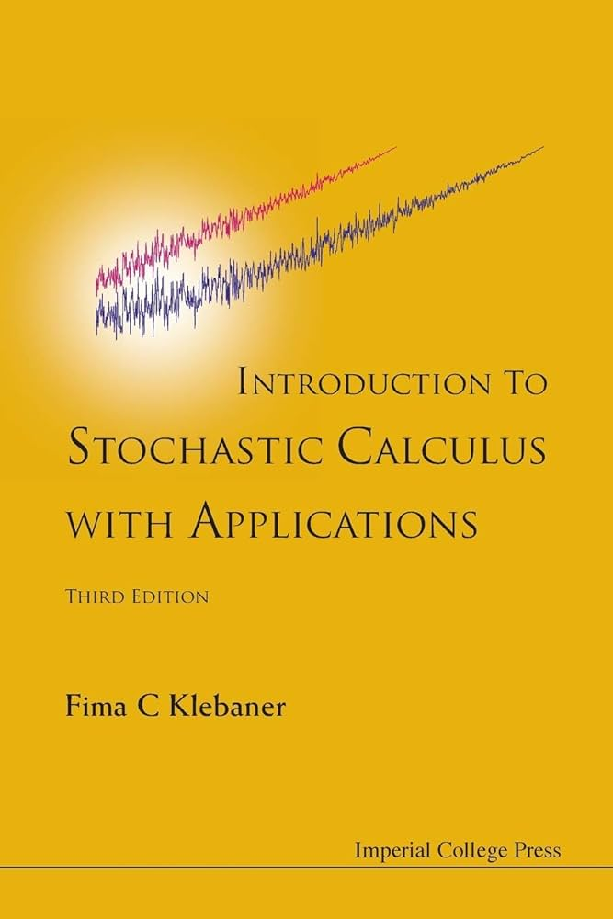

Candidacy References
LeVeque
Klebaner
Landau
Swaters

Slide 4
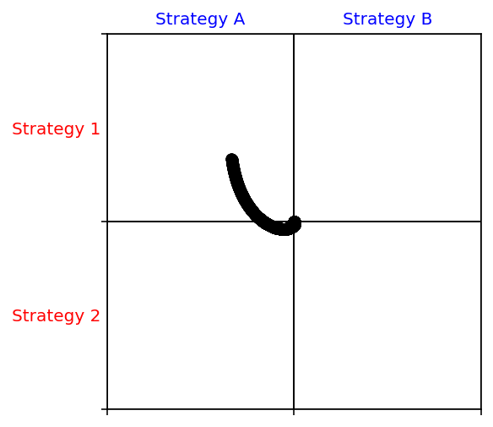
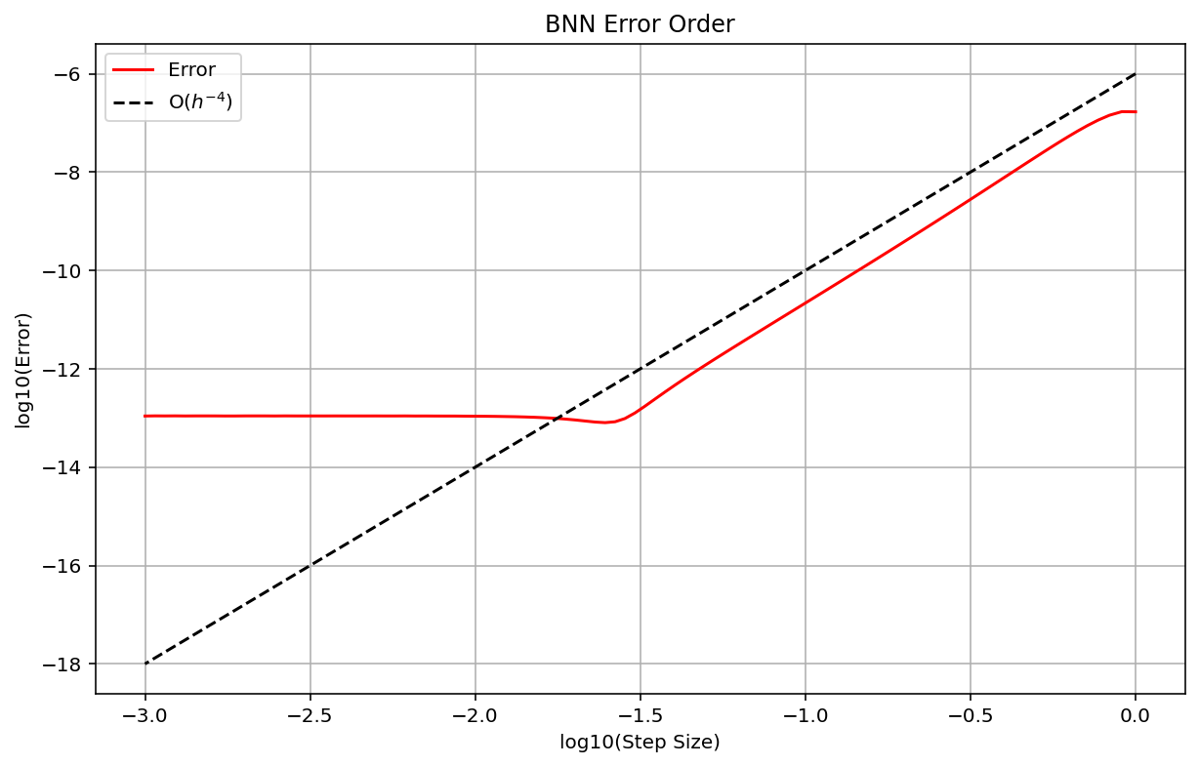

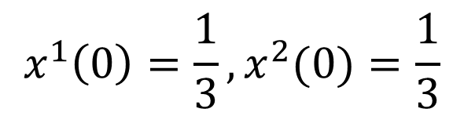
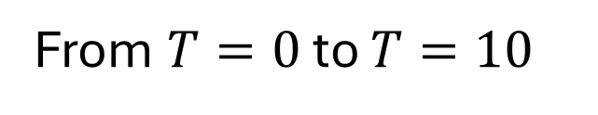
Last Time: Soft ReLU Activation Function
$$x^{1}\left(0\right)=\frac{1}{3},x^{2}(0)=\frac{1}{3}$$
Activation Function
From $T=0$ to $T=10$
$$φ(x)=ln(1+e^{x})$$

Slide 5
Convergence of RK 4 Solution to Actual Solution
What happens with Soft ReLU when the Nash Equilibrium is no longer $(\frac{1}{2},\frac{1}{2})?$
Player 1 Payoff Matrix
Player 2 Payoff Matrix
Player 2
Player 2
A
B
A
B
1
2 | 4
11 | 1
1
8 | 5
6 | 23
Player 1
Player 1
2
2
Player 1 Strategy:${ p}^{1}=(x^{1},y^{1})$ Player 2 Strategy:${ p}^{2}=(x^{2},y^{2})$

Slide 6
Convergence of RK 4 Solution to Actual Solution
Nash Equilibrium is now at: ${ p}^{1}=(\frac{17}{20},\frac{3}{20})$,${ p}^{2}=(\frac{1}{4},\frac{3}{4})$
Player 1 Payoff Matrix
Player 2 Payoff Matrix
Player 2
Player 2
A
B
A
B
1
2 | 4
11 | 1
1
8 | 5
6 | 23
Player 1
Player 1
2
2
Player 1 Strategy:${ p}^{1}=(x^{1},y^{1})$ Player 2 Strategy:${ p}^{2}=(x^{2},y^{2})$

Slide 7
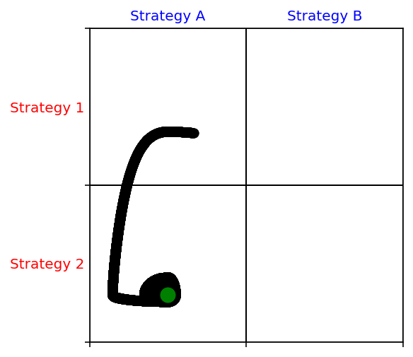
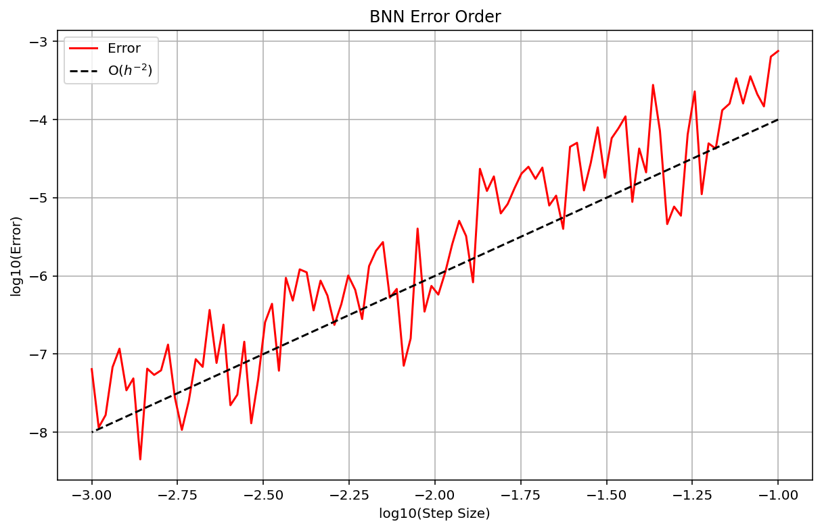

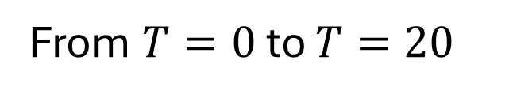
Testing Out New Payoff Matrices
Standard ReLU with New Payoff Matrices
$$x^{1}\left(0\right)=\frac{1}{3},x^{2}(0)=\frac{1}{3}$$
* Comparison with RK45
Activation Function
From $T=0$ to $T=20$
$$φ(x)=max(0,x)$$

Slide 8
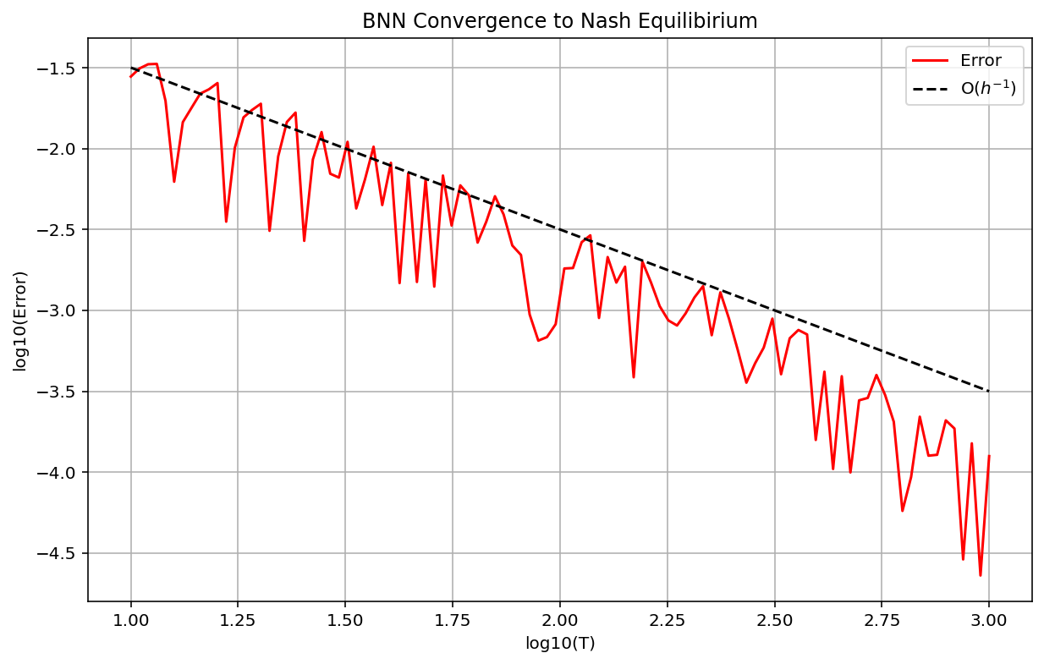

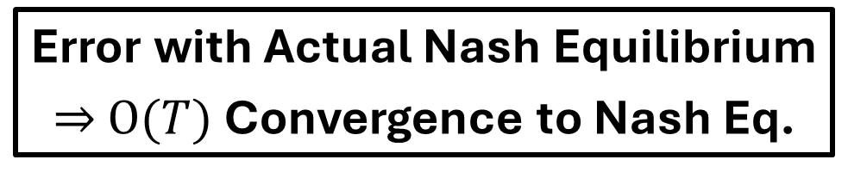

Testing Out New Payoff Matrices
Standard ReLU with New Payoff Matrices
$$O(t^{−1})$$
Error with Actual Nash Equilibrium
$⇒$ $O(T)$Convergence to Nash Eq.
Larger Payoffs make Step Size of ${10}^{0}$ unstable

Slide 9

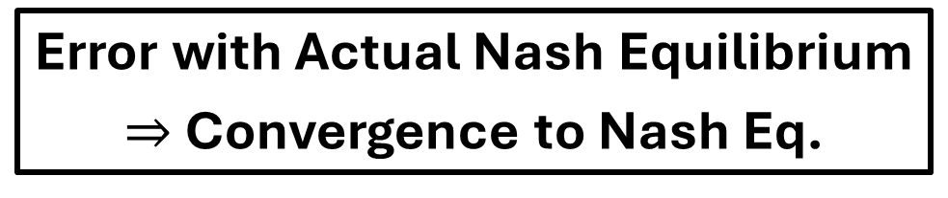
Testing Out New Payoff Matrices
Standard ReLU with New Payoff Matrices
$$O(t^{−1})$$
What If We Scaled The New Payoff Matrices??
Error with Actual Nash Equilibrium
$⇒$ Convergence to Nash Eq.
Larger Payoffs make Step Size of ${10}^{0}$ unstable

Slide 10
Testing Out New Payoff Matrices
Standard ReLU with Scaled New Payoff Matrices
Nash Equilibrium is now at: ${ p}^{1}=(\frac{17}{20},\frac{3}{20})$,${ p}^{2}=(\frac{1}{4},\frac{3}{4})$
Player 1 Payoff Matrix
Player 2 Payoff Matrix
Player 2
Player 2
A
B
A
B
1
1/10 | 3/10
1 | 0
1
1/6 | 0
1/18 | 1
Player 1
Player 1
2
2
Player 1 Strategy:${ p}^{1}=(x^{1},y^{1})$ Player 2 Strategy:${ p}^{2}=(x^{2},y^{2})$

Slide 11
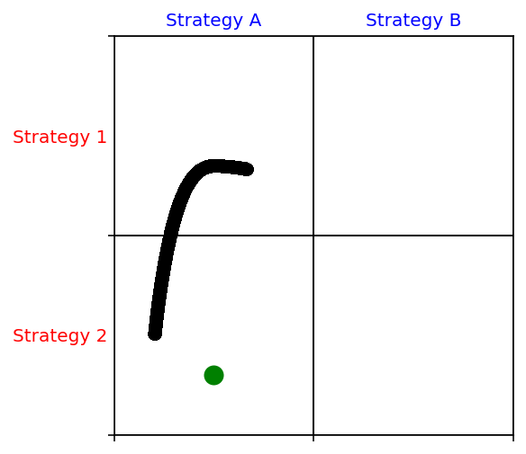
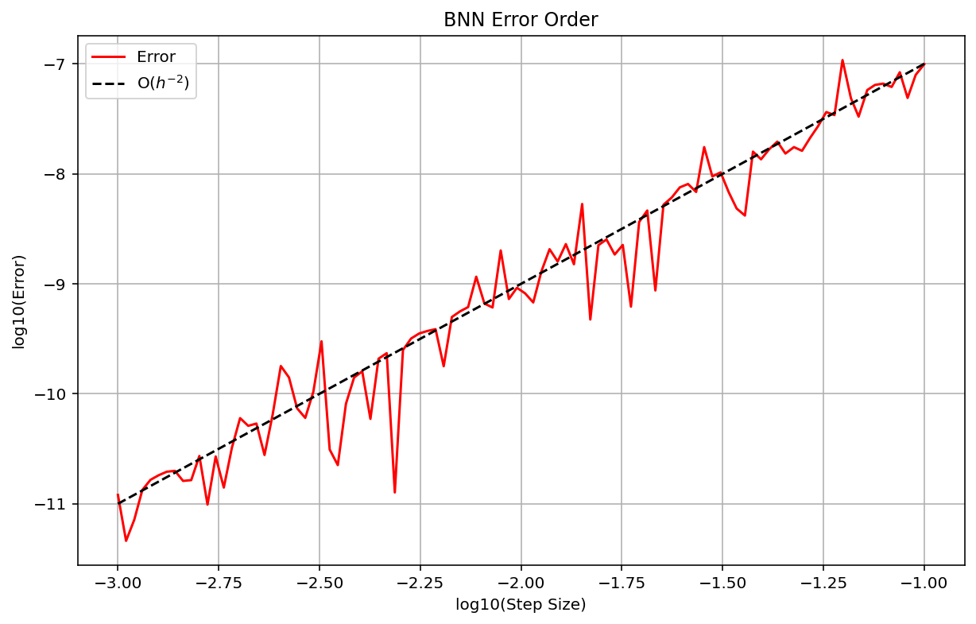
Testing Out New Payoff Matrices
Standard ReLU with Scaled New Payoff Matrices
$$x^{1}\left(0\right)=\frac{1}{3},x^{2}(0)=\frac{1}{3}$$
* Comparison with RK45
Activation Function
From $T=0$ to $T=20$
$$φ(x)=max(0,x)$$

Slide 12
Testing Out New Payoff Matrices
Standard ReLU with Scaled New Payoff Matrices
Lower Payoff Magnitudes Reduces Convergence Time
Much Lower Errors with Smaller Magnitude Payoffs

Slide 13
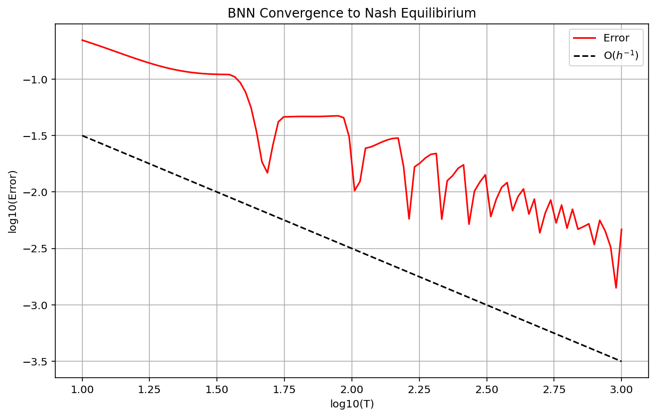

Testing Out New Payoff Matrices
Standard ReLU with New Payoff Matrices
$$O(t^{−1})$$
$$O(t^{−1})$$
Convergence to Nash Eq. with Scaled Payoff Matrices
Convergence to Nash Eq. with Normal Payoff Matrices

Slide 14
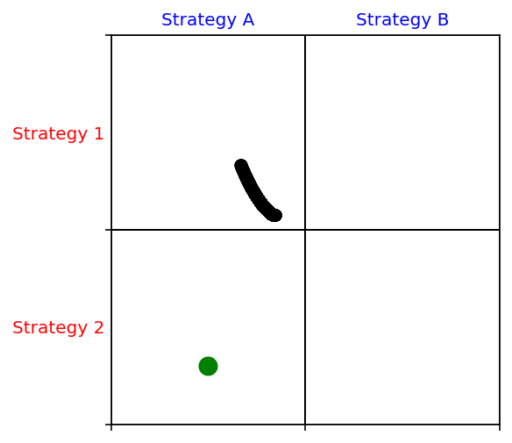
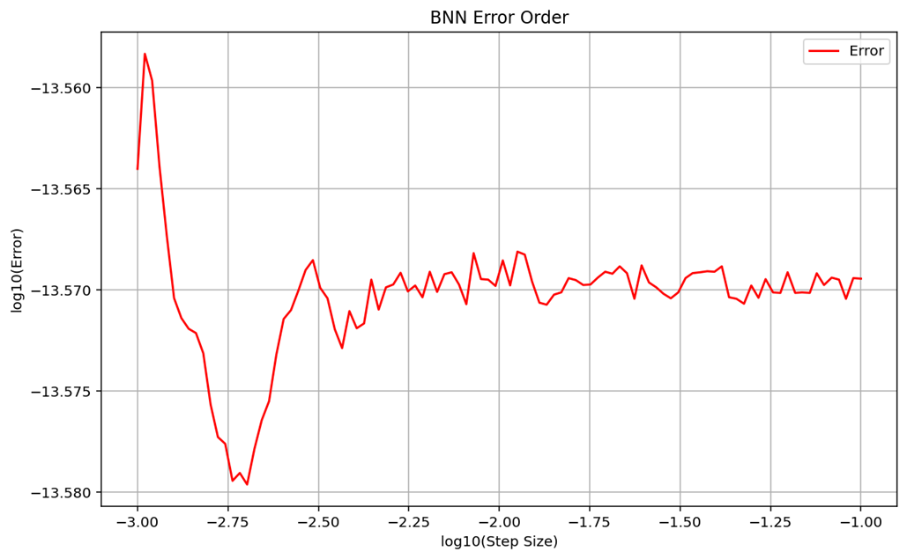

Soft ReLU with Scaled New Payoff Matrices
$$x^{1}\left(0\right)=\frac{1}{3},x^{2}(0)=\frac{1}{3}$$
* Comparison with RK45
Activation Function
From $T=0$ to $T=20$
$$φ(x)=ln(1+e^{x})$$

Slide 15
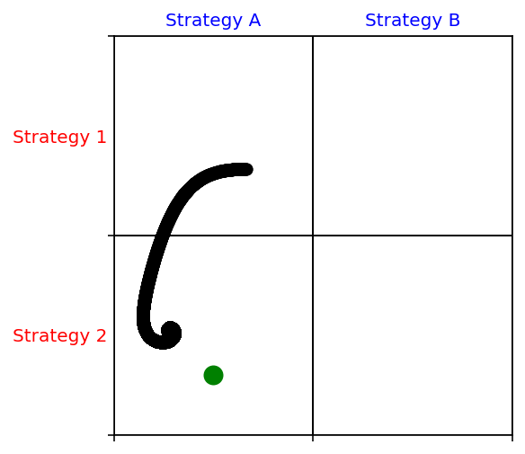
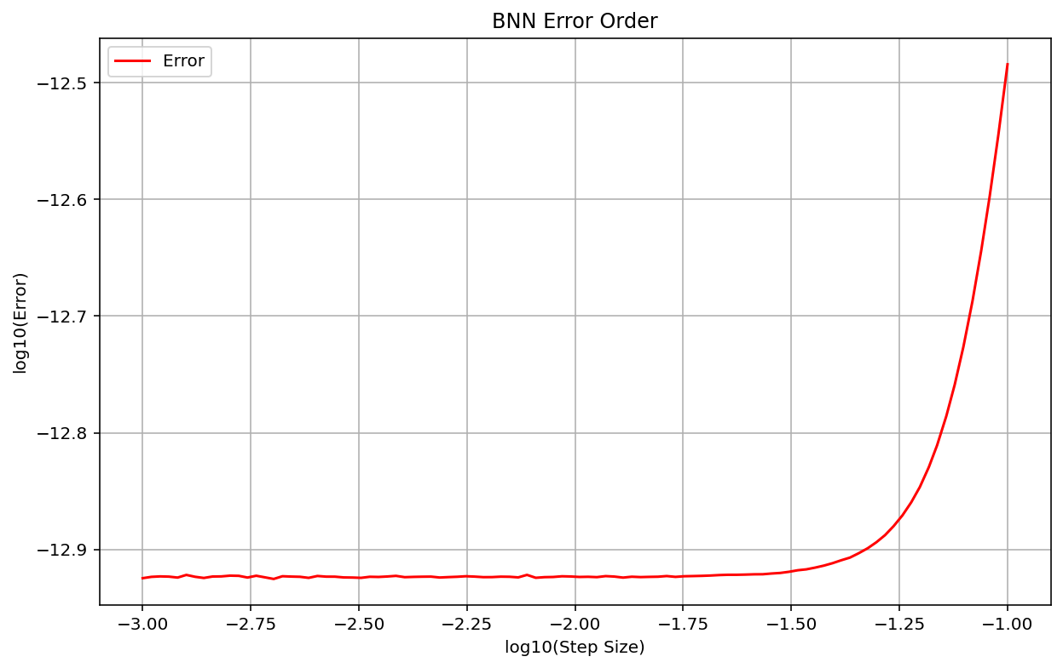
Soft ReLU with New Payoff Matrices
No Convergence to Nash Eq.
High Accuracy with Respect to RK45

Slide 16
Soft ReLU with Scaled New Payoff Matrices
No Convergence to Nash Eq.
High Accuracy with Respect to RK45

Slide 17
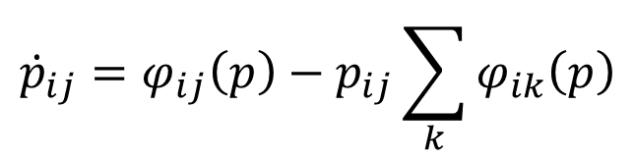
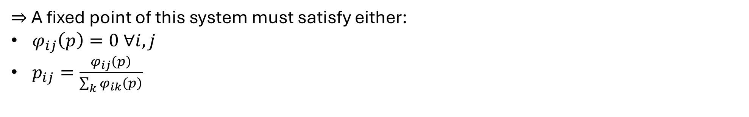
Why Doesn’t Soft ReLU Work?
BNN Dynamics requires that the Nash Equilibrium is a fixed point of the dynamical system
BNN Dynamics uses the following ODE:
$${\dot{p}}_{ij}=φ_{ij}\left(p\right)−p_{ij}\sum_{k}{φ_{ik}\left(p\right)}$$
A fixed point of this system must satisfy ${\dot{p}}_{ij}=0 ∀i,j$
$⇒$A fixed point of this system must satisfy either:
$φ_{ij}\left(p\right)=0 ∀i,j$
$p_{ij}=\frac{φ_{ij}\left(p\right)}{\sum_{k}{φ_{ik}\left(p\right)}}$
Fulfilling the second condition seems to require knowing the Nash equilibrium beforehand

Slide 18
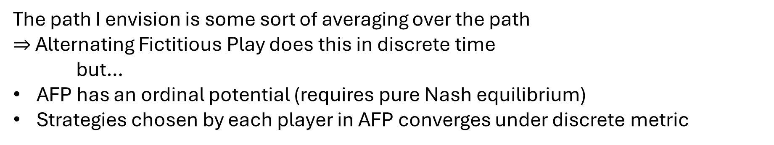
Recovering Nash Equilibriums from Strategy Trajectory
If the Nash Equilibrium isn’t the fixed point of BNN, can we still recover the Nash Equilibrium from the strategy trajectory?
The path I envision is some sort of averaging over the path
$⇒$ Alternating Fictitious Play does this in discrete time
but…
AFP has an ordinal potential (requires pure Nash equilibrium)
Strategies chosen by each player in AFP converges under discrete metric

Slide 19

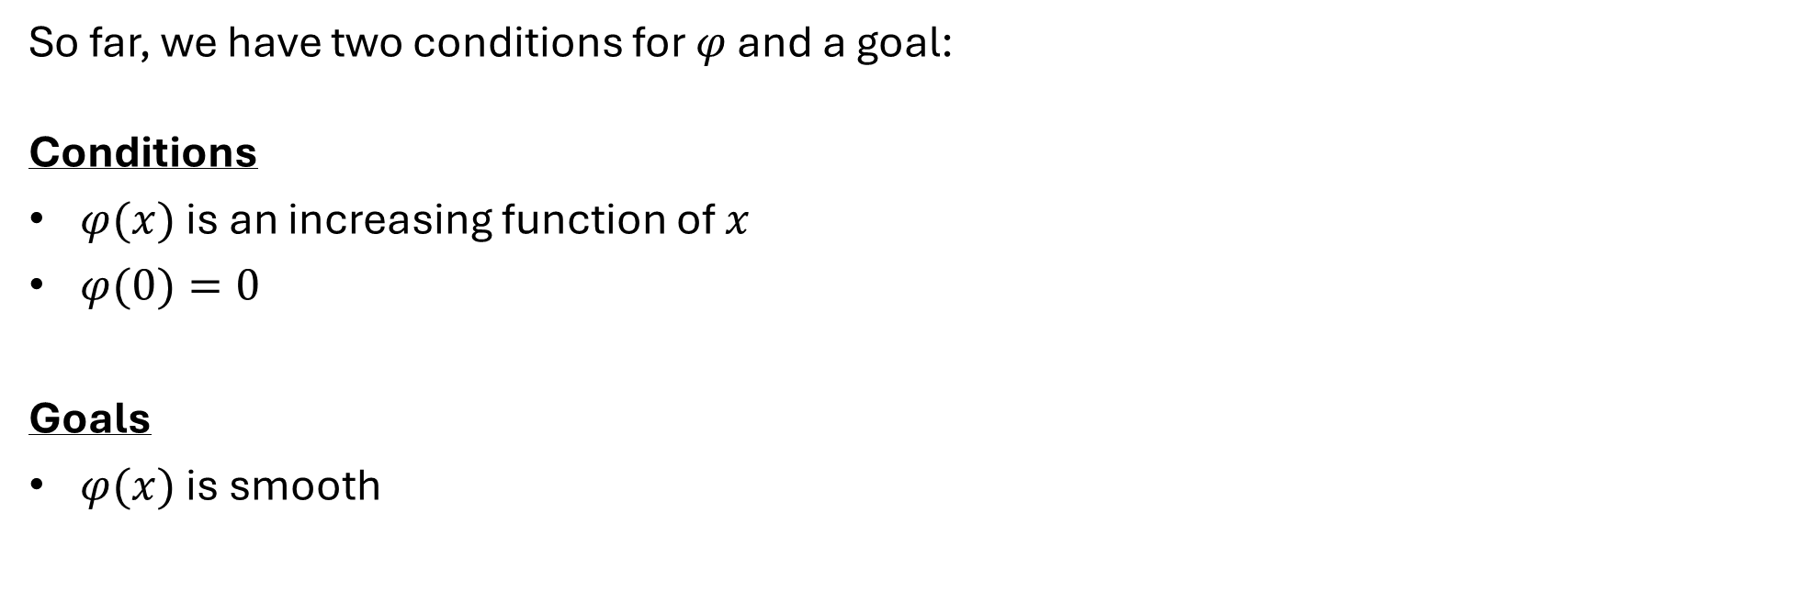
Intro to $φ$ Engineering
So far, we have two conditions for $φ$ and a goal:
Conditions
$φ(x)$ is an increasing function of $x$
$φ(0)=0$
Goals
$φ(x)$ is smooth
Open Question
Does convexity matter??

Slide 20

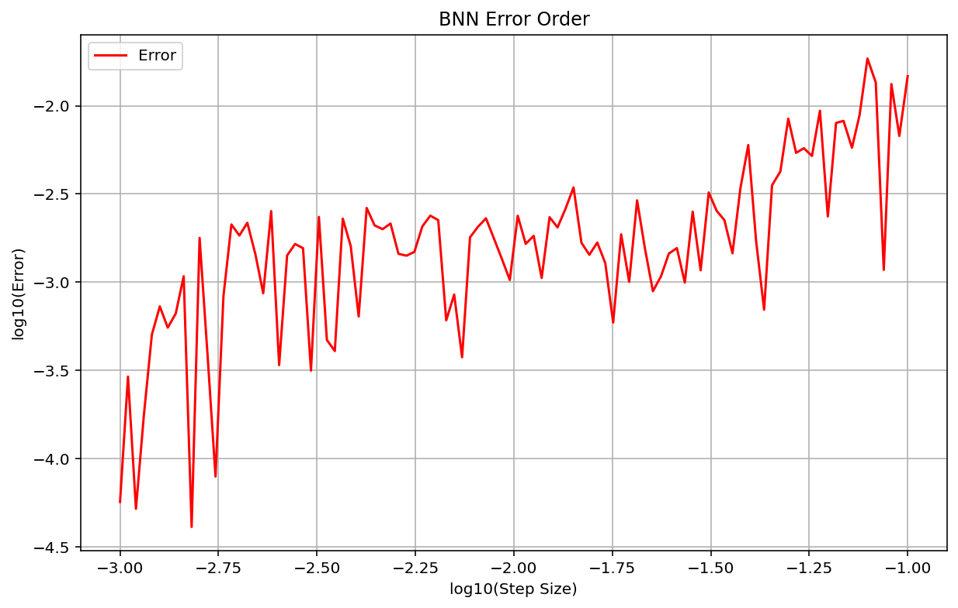
Does Convexity Matter?
$$x^{1}\left(0\right)=\frac{1}{3},x^{2}(0)=\frac{1}{3}$$
* Comparison with RK45
Activation Function
From $T=0$ to $T=20$
$$φ(x)=0 if x≤0,\sqrt{x} Otherwise$$

Slide 21
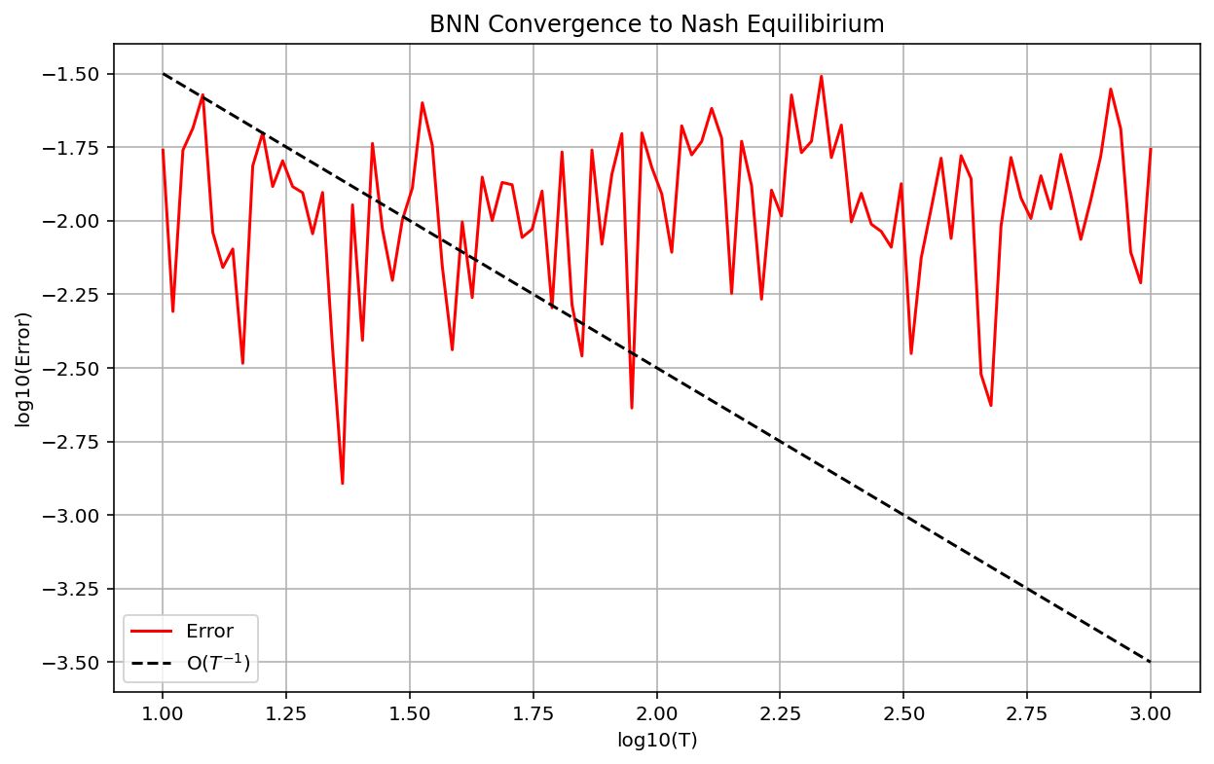
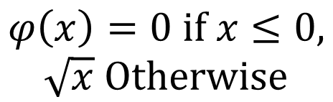
Does Convexity Matter?
Activation Function
$$φ\left(x\right)=0 if x≤0,$$
$$\sqrt{x} Otherwise$$
System quickly reached Nash Equilibrium

Slide 22

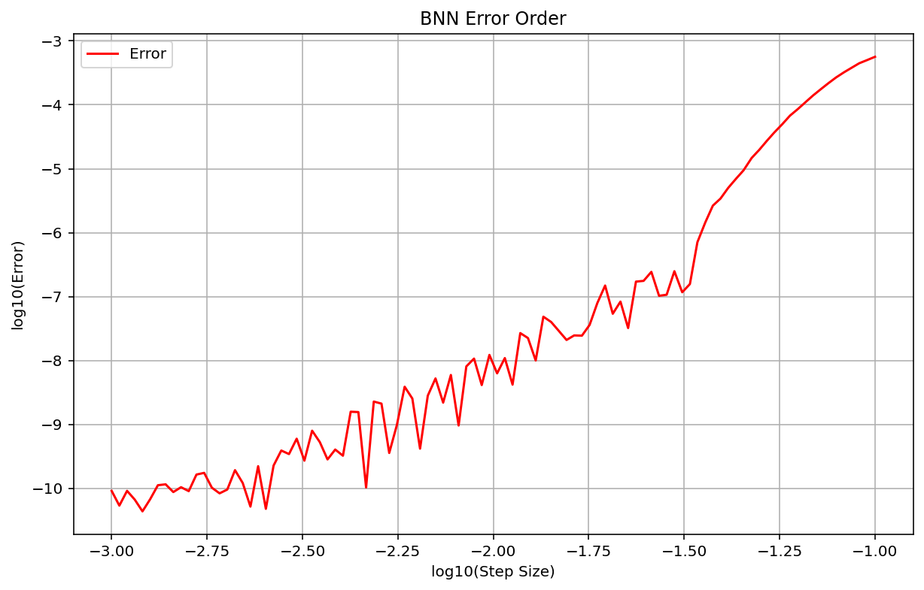
Does Convexity Matter?
$$x^{1}\left(0\right)=\frac{1}{3},x^{2}(0)=\frac{1}{3}$$
* Comparison with RK45
Activation Function
From $T=0$ to $T=20$
$$φ(x)=0 if x≤0,x^{2} Otherwise$$

Slide 23
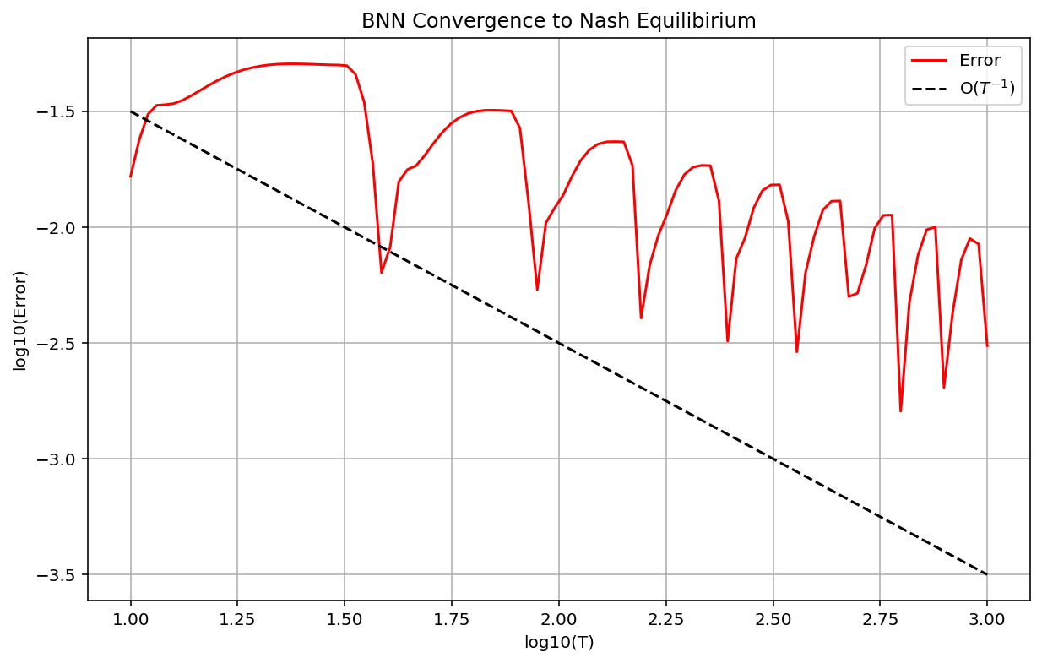
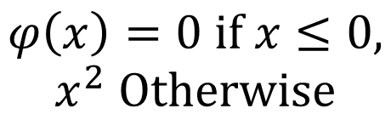
Does Convexity Matter?
Activation Function
$$φ\left(x\right)=0 if x≤0,$$
$$x^{2} Otherwise$$
System Taking Longer TO Reach Nash Equilibrium But Improving Over Time

Slide 24
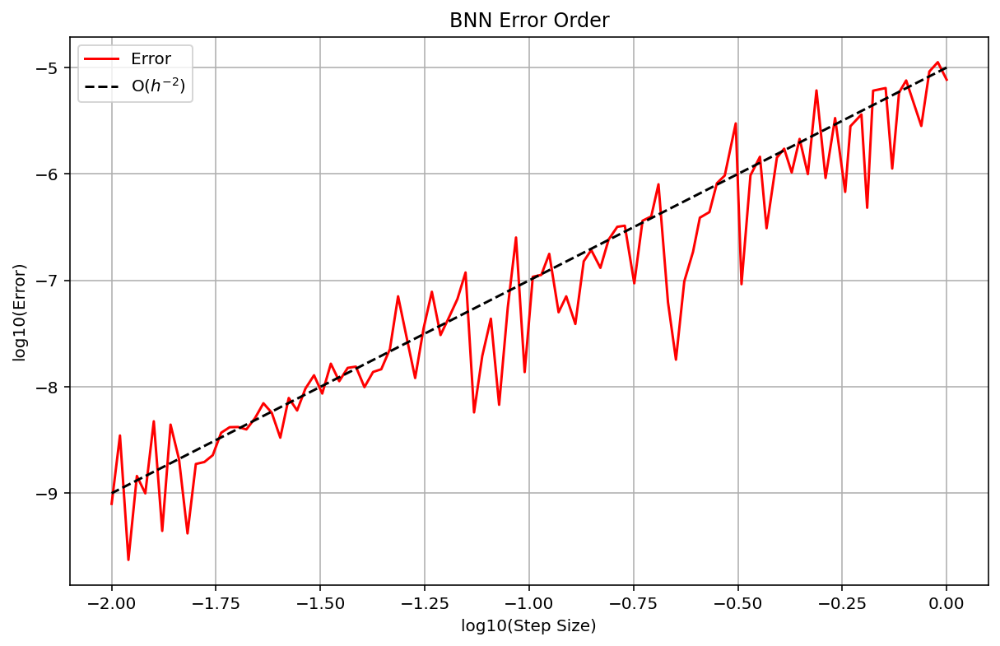


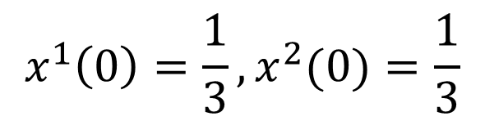
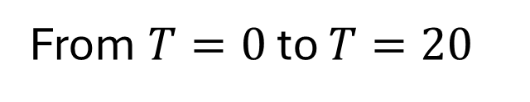
“Actual” Solution as RK4 with ${10}^{−3}$ Step Size
Open Question: What does accuracy look like when we compare RK4 with a step size in $[{10}^{−2},{10}^{0}]$to RK4 with a step size of ${10}^{−3}$?
Still Jagged, Likely From Changing Step Size Changing the “Jacobian Jump”
Activation Function
$$φ(x)=max(0,x)$$
$$x^{1}\left(0\right)=\frac{1}{3},x^{2}(0)=\frac{1}{3}$$
From $T=0$ to $T=20$

Slide 25
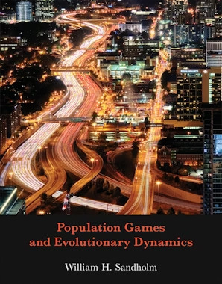
BNN Dynamics Academic Reference
This textbook provides a systematic presentation of evolutionary game theory
Topics Include:
Stochastic Evolutionary Processes
Evolutionary Dynamics
Iterative Solution Concepts
Stochastic Stability

Slide 26
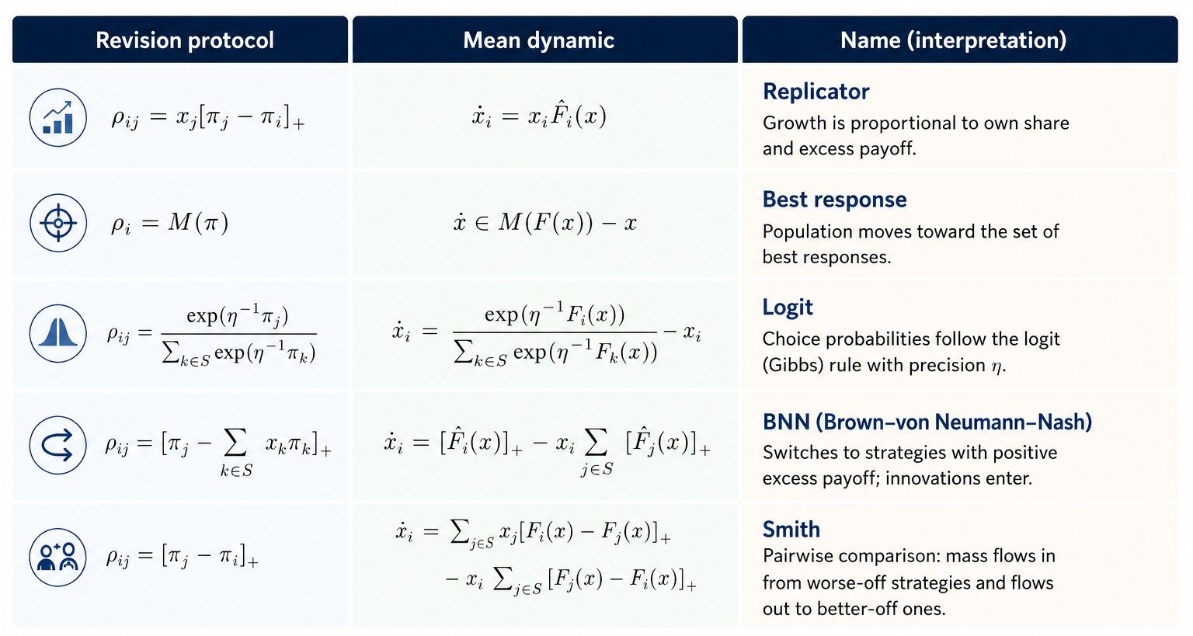
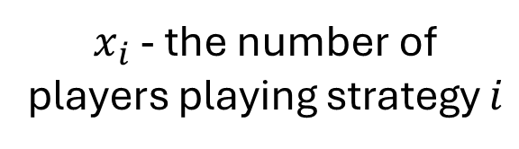
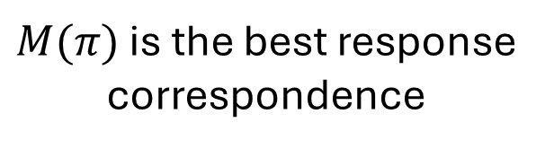
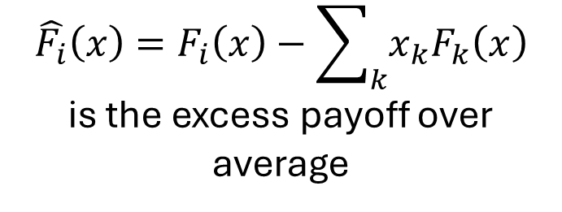
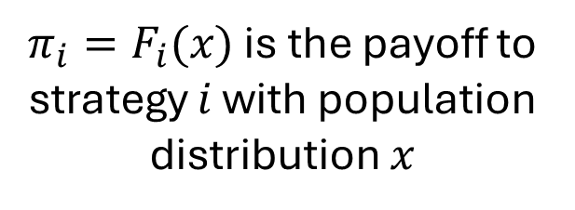
Evolutionary Dynamics
$x_{i}$ - the number of players playing strategy $i$
$π_{i}=F_{i}(x)$ is the payoff to strategy $i$ with population distribution $x$
$$\hat{F_{i}}\left(x\right)=F_{i}\left(x\right)−\sum_{k}{x_{k}F_{k}\left(x\right)}$$
is the excess payoff over average
$M(π)$ is the best response correspondence

Slide 27

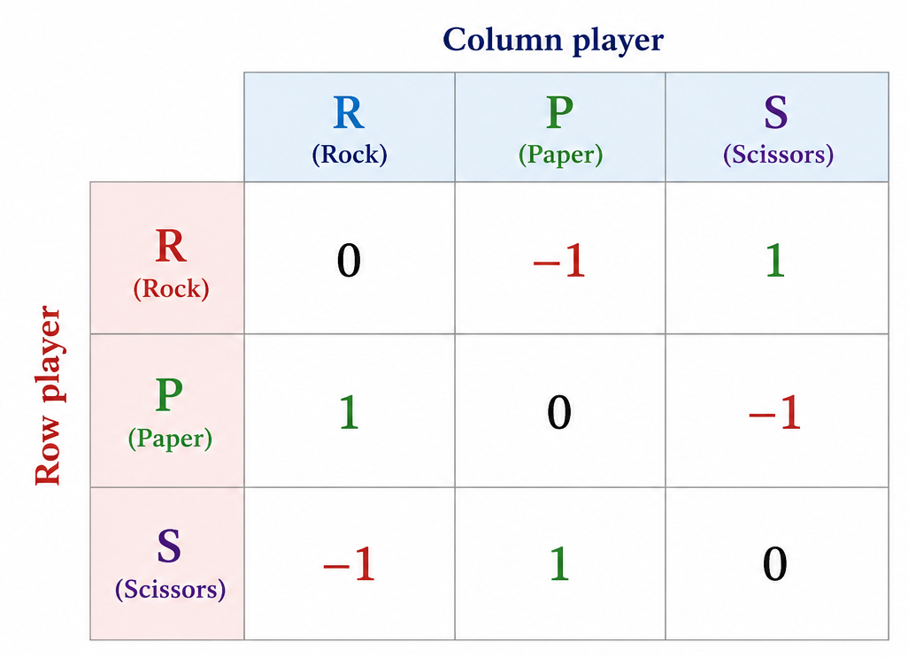
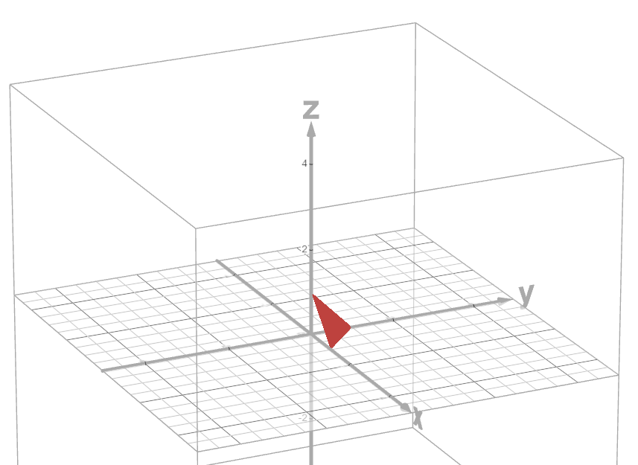
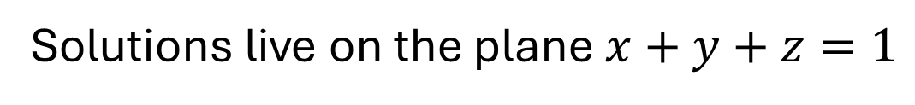
Evolutionary Dynamics with Rock-Paper-Scissors
Player 2
Player 1 Payoff Matrix
Player 1
[ Zero Sum Game ]
Solutions live on the plane $x+y+z=1$

Slide 28
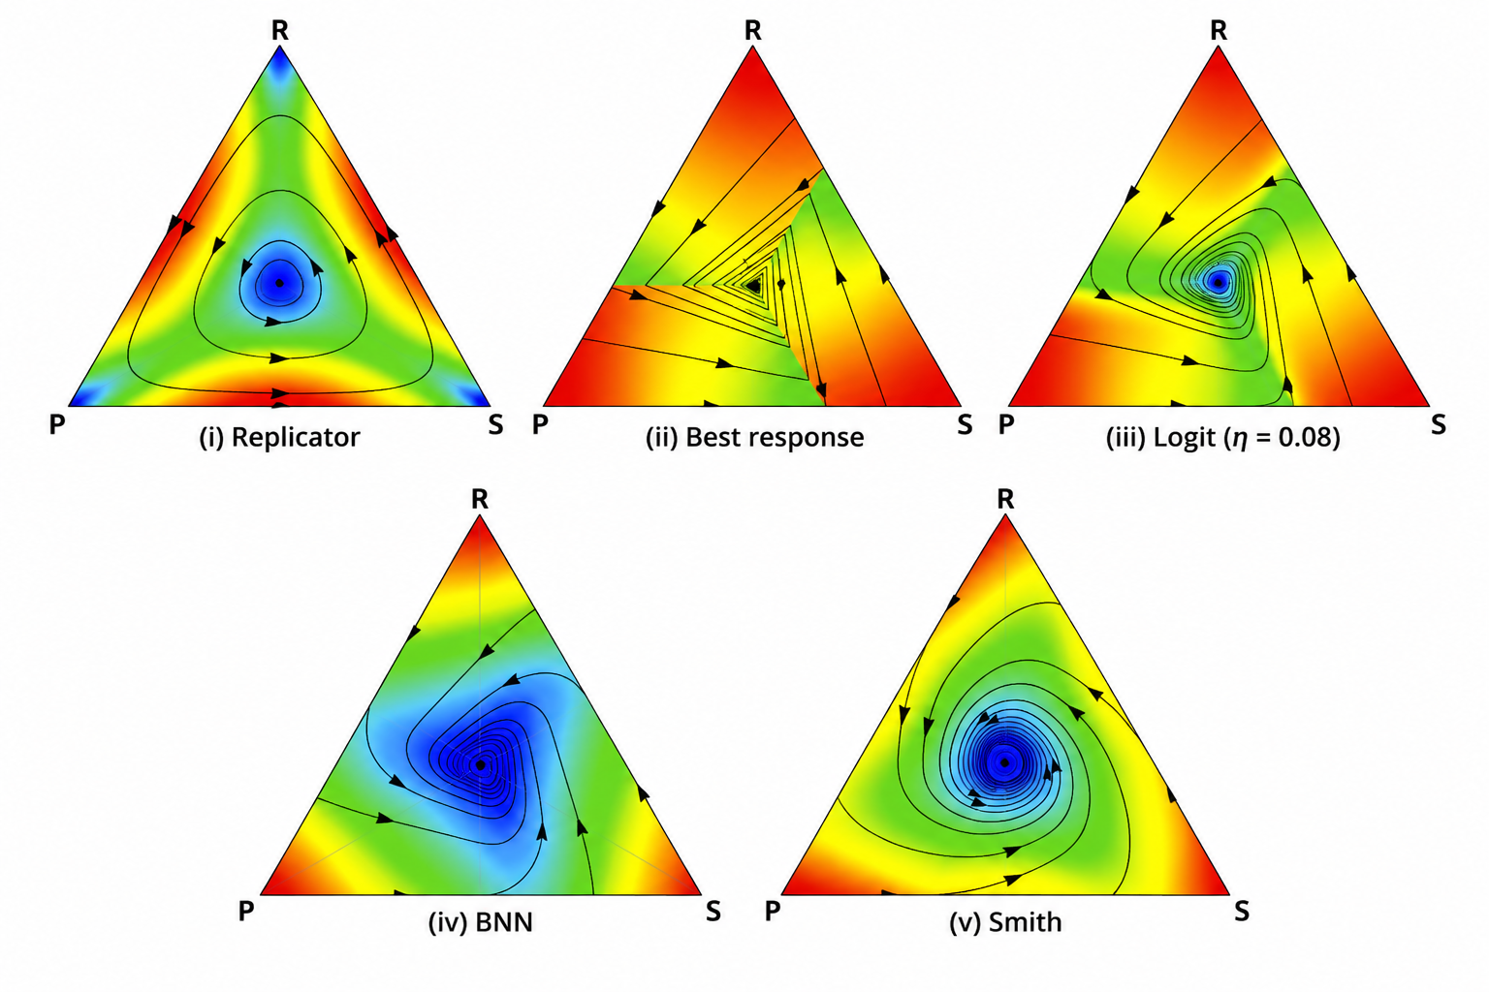
Evolutionary Dynamics with Rock-Paper-Scissors
The Trajectory Is the Population Strategy Density Over Time
Shading Represents The Speed At Which The Density Changes

Slide 29
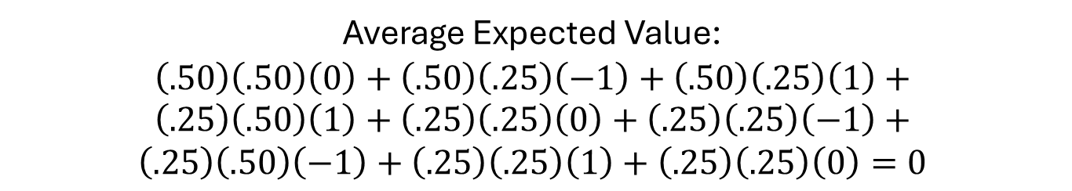
Replicator Dynamics
A Population Grows if Expected Value > Average
If system starts at $50$% Rock, $25$% Paper, $25$% Scissors:
Average Expected Value:
$$\left(.50\right)\left(.50\right)\left(0\right)+\left(.50\right)\left(.25\right)\left(−1\right)+\left(.50\right)\left(.25\right)\left(1\right)+$$
$$\left(.25\right)\left(.50\right)\left(1\right)+\left(.25\right)\left(.25\right)\left(0\right)+\left(.25\right)\left(.25\right)\left(−1\right)+$$
$$\left(.25\right)\left(.50\right)\left(−1\right)+\left(.25\right)\left(.25\right)\left(1\right)+\left(.25\right)\left(.25\right)\left(0\right)=0$$
Expected Value of Rock: $.50\left(0\right)+.25\left(−1\right)+.25\left(1\right)=0$
Expected Value of Paper: $.50\left(1\right)+.25\left(0\right)+.25\left(−1\right)=\text{.25}$
Expected Value of Scissors: $.50\left(−1\right)+.25\left(1\right)+.25\left(0\right)=−\text{.25}$
Rock doesn’t change, Paper grows, Scissors shrinks

Slide 30
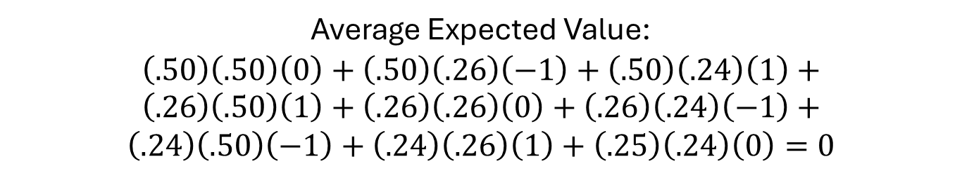
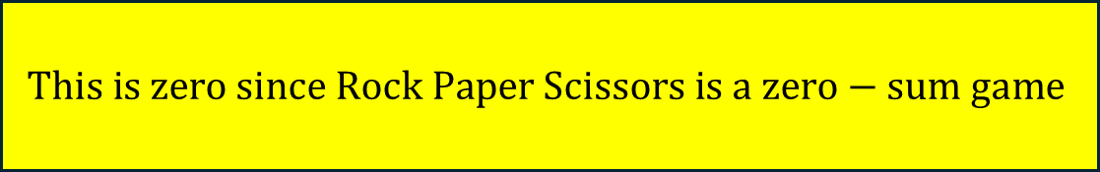
Replicator Dynamics
A Population Grows if Expected Value > Average
If system starts at $50$% Rock, $26$% Paper, $24$% Scissors:
Average Expected Value:
$$\left(.50\right)\left(.50\right)\left(0\right)+\left(.50\right)\left(.26\right)\left(−1\right)+\left(.50\right)\left(.24\right)\left(1\right)+$$
$$\left(.26\right)\left(.50\right)\left(1\right)+\left(.26\right)\left(.26\right)\left(0\right)+\left(.26\right)\left(.24\right)\left(−1\right)+$$
$$\left(.24\right)\left(.50\right)\left(−1\right)+\left(.24\right)\left(.26\right)\left(1\right)+\left(.25\right)\left(.24\right)\left(0\right)=0$$
$$This is zero since Rock Paper Scissors is a zero−sum game$$
Expected Value of Rock: $.50\left(0\right)+.26\left(−1\right)+.24\left(1\right)=−.02$
Expected Value of Paper: $.50\left(1\right)+.26\left(0\right)+.24\left(−1\right)=\text{.2}\text{6}$
Expected Value of Scissors: $.50\left(−1\right)+.26\left(1\right)+.24\left(−1\right)=.02$
Rock shrinks, Paper grows, Scissors shrinks

Slide 31

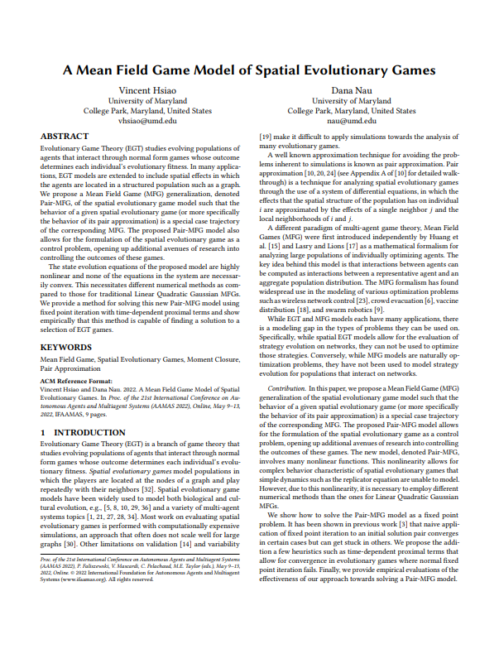
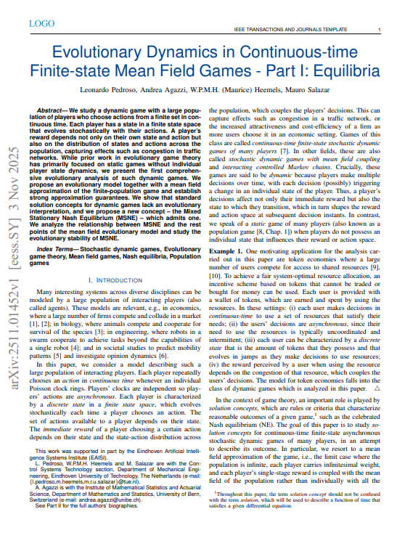
Evolutionary Dynamics and Mean Field Games

